Slide 1
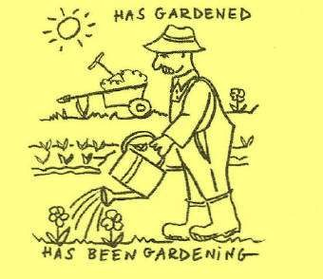
PRESENT PERFECT versus PRESENT PERFECT PROGRESSIVE

Slide 2
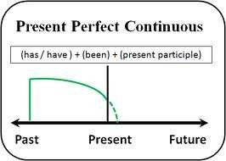
PRESENT PERFECT CONTINOUS
We use the Present Perfect Continuous to emphasize the duration or continuous course of an action.
I HAVE BEEN READING A BOOK
To indicate the duration of an action that started in the past
I HAVE BEEN PLAYING TENNIS FOR TWO HOURS
If we use this tense it means that the duration of the action is long
Duration (how long)
I have been writing for an hour.

Slide 3


PRESENT PERFECT
We use the Present Perfect Simple mainly to express that an action is completed or to emphasize the result or to indicate that action has not changed
I HAVE READ A BOOK
TODAY I HAVE READ TEN BOOKS HE HAS GONE TO CANADA
Result (what / how much / how often) I have written 5 letters.
I have been to London twice.

Slide 4

COMPARISON BETWEEN PRESENT PERFECT AND PRESENT PERFECT PROGRESSIVE
Emphasis on completion
SHE HAS DONE HER HOMEWORK
(Meaning: Her homework is completed now.)
Emphasis on duration
SHE HAS BEEN DOING HER HOMEWORK
Meaning: That's how she has spent her time. It does not matter whether the homework is completed now.)

Slide 5

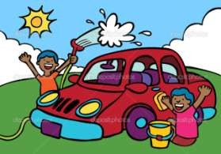
COMPARISON BETWEEN PRESENT PERFECT AND PRESENT PERFECT PROGRESSIVE
desired result
I have washed the car.
(Result: The car is clean now
unwanted side effect
Why are you so wet? - I have been washing the car. (side effect: I became wet when I was washing the car. It does not matter whether the car is clean now.)
).

Slide 6
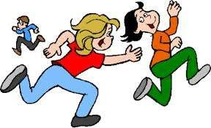
COMPARISON BETWEEN PRESENT PERFECT AND PRESENT PERFECT PROGRESSIVE
*to express how much time has past since the last time the action took place
since the last time
I haven't played that game for years. (Meaning: It's years ago
that I last played that game.)
* To express how much time has past since the beginning of the action
I haven't been playing that game for an hour, only for 10 minutes. (Meaning: It's not even an hour ago that I started to play that game.)

Slide 7
Task 1: Choose the correct answer.
Her eyes hurt because she has been looking/has looked at that computer screen for hours.
I'm tired because I have not been having/have not had holiday for ages.
It has been snowing/has snowed for hours. If it continues we won't be able to go to school tomorrow.
I hope Tom's alright. We have not been seeing/have not seen him recently.
The office is really busy. The phones have rung/have been ringing all day.
Have you read/have you been reading any of Alan Bennett's work?
They're tired because they have been cycling/have cycled over thirty miles today.
We have been waiting/have waited for over half an hour and there's still no sign of the bus.

Slide 8
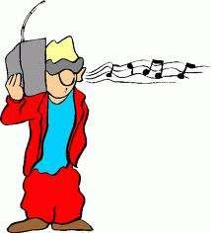
Task 2 : CHOOSE PRESENT PERFECT OR PRESENT PERFECT PROGRESSIVE
This evening I two letters to my parents (to write)
My daughter letters to her friends for hours (to write)
Today Lucy her best friend three
times (to call)
My friends around Italy for five months (to travel)
I to music all evening (to listen)
I English since I was a child (to learn)
Such a pleasant weather! It ___________since yesterday (to rain)

